Slide 1
Incorporating Mathematical Mindsets georgewoodbury.com/mindsets
Louisville, KY – November 2018

Slide 2
Introduction:
A Tale of Two Instructors

Slide 3
Introduction
Jo Boaler:
A lot of scientific evidence suggests that the difference between those who succeed and those who don't is not the brains they were born with, but their approach to life, the messages they receive about their potential, and the opportunities they have to learn.
Notes:
The very best opportunities to learn come about when students believe in themselves.

Slide 4
Books

Slide 5
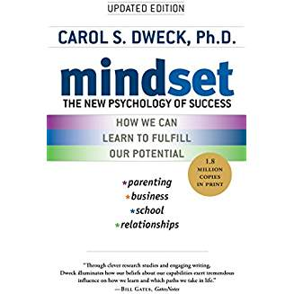
Carol Dweck
Mindset – The New Psychology of Success

Slide 6
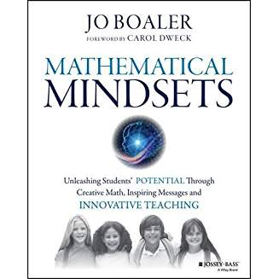
Jo Boaler
Mathematical Mindsets

Slide 7
Definitions

Slide 8
Mindsets
Mindsets are beliefs – beliefs about yourself and your most basic qualities (intelligence, talents, personality).
- Carol Dweck
Are these fixed traits, or can you grow them over time?

Slide 9
Fixed Mindset
People believe that their intelligence and abilities are fixed traits.
Talent alone creates success—without effort.
People in this mindset worry about their traits and how adequate they are. They have something to prove to themselves and others.
Notes:
You can either do math or not. “Math Person”
They have a certain amount of brains and talent and nothing can change that. If they have a lot, they’re all set, but if they don’t...

Slide 10
Growth Mindset
People believe that their intelligence and abilities can be developed through hard work.
Intelligence and talent are a starting point.
This mindset creates a love of learning and resilience.
Notes:
Intelligence is like a muscle – it can grow!
Research has shown there is a relationship between a student’s mindset and their achievement. Mindset impacts motivation, academic behaviors, and responses to challenges/setbacks

Slide 11
Comparing the Two Mindsets - Goals
Fixed:
  Concerned how they’ll be judged
Growth:
  Concerned with improving
Notes:
Fixed: Look smart at all costs
Growth: Goal is learning, do whatever it takes

Slide 12
Comparing the Two Mindsets - Failure
Fixed:
  Failure is a setback
Growth:
  Failure is about not growing
Notes:
Children with the fixed mindset want to make sure they succeed. Smart people should always succeed.
Failure has been transformed from an action (I failed) to an identity (I am a failure).
And in the fixed mindset, a loser is forever.
Growth Mindset: “Becoming is better than being.” The fixed mindset does not allow people the luxury of becoming. They have to already be.
Another way people with the fixed mindset try to repair their self-esteem after a failure is by assigning blame or making excuses.
This low-effort syndrome is also a way that students with the fixed mindset protect themselves.

Slide 13
Failure/Setback
Students with a fixed-mindset will reduce their effort, leading to lower achievement.
Students with a growth-mindset will work harder, leading to higher achievement.
These are self-perpetuating cycles, especially in math.

Slide 14
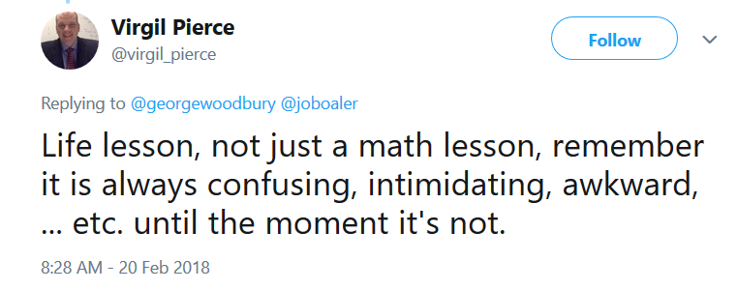
Persistence

Slide 15
Comparing the Two Mindsets - Effort
Fixed:
  Effort is a bad thing
Growth:
  Effort is what makes you smart and talented
Notes:
Fixed: Effort means you are not a natural
Don’t even try
Growth: Do whatever it takes

Slide 16
Our Role
Instructors are an important resource for students, and we have a great impact on student learning.
Notes:
Help them develop a growth mindset.

Slide 17
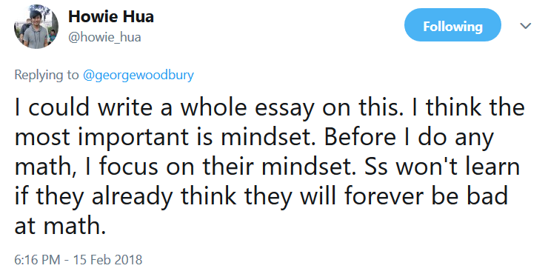
Our Role
Notes:
Help them develop a growth mindset.

Slide 18
Helping Your Students to Develop a Growth Mindset in Math

Slide 19
It’s Not Easy
Adopting a growth mindset is about changing your view and looking at things in a different way.
Notes:
Many people with the fixed mindset think the world needs to change, not them.
For a long time, it’s frightening to think of giving up the idea of being superior.

Slide 20
Think/Pair/Share
Give an example, in detail, of an area in which you once had low ability but now perform well.

Slide 21
Day One Survey Prompts
Give an example, in detail, of an area in which you once had low ability but now perform well.
List a mistake you made that taught you something.
List a skill that you picked up that required a lot of practice.
Tell me about a person that you saw learn how to do something you never thought that person could do.

Slide 22
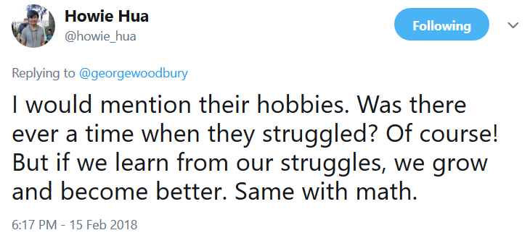
Developing a Growth Mindset

Slide 23
Developing a Growth Mindset – Videos
Have your students watch a mindset video.
Carol Dweck’s TED talk
Jo Boaler’s TED talk
Pearson mindset videos by Dave Paunesku
(I have YouTube links to the TED talks on the mindsets page on my website.)

Slide 24
Developing a Growth Mindset – Mindset Assessment
Have your students take a mindset assessment.
(I have a link to Carol Dweck’s website that has an assessment you can use.)

Slide 25
Developing a Growth Mindset – Following Up
Carol Dweck:
Is there something in your past that you think measured you?
Focus on that thing.
Now put it in a growth-mindset perspective.
What did I (or can I) learn from that experience? How can I use it as a basis for growth? Carry that with you instead.

Slide 26
Developing a Growth Mindset – Following Up
Consider having your students retake the mindset assessment to measure their progress.
Give your students another of the prompts, but reframe it in terms of your class.

Slide 27
Misinterpretations

Slide 28
Misinterpretations
The focus is on effort, not on success.

Slide 29
Misinterpretations - Effort
Carol Dweck:
A growth mindset isn’t just about effort.
Perhaps the most common misconception is simply equating the growth mindset with effort. Certainly, effort is key for students’ achievement, but it’s not the only thing. Students need to try new strategies and seek input from others when they’re stuck. They need this repertoire of approaches—not just sheer effort—to learn and improve.

Slide 30
Misinterpretations
Instructors using this approach are lowering standards.

Slide 31
Misinterpretations – Lowering Standards
Carol Dweck:
Many educators think that lowering their standards will give students success experiences, boost their self-esteem, and raise their achievement.
Well, it doesn’t work. Lowering standards just leads to poorly educated students who feel entitled to easy work and lavish praise.
Simply raising standards in our schools, without giving students the means of reaching them, is a recipe for disaster.

Slide 32
Misinterpretations
False Growth-Mindset

Slide 33
Messages

Slide 34
Messages
The messages we send to our students are so important.

Slide 35
“Math Person”
For example …
Teachers need to replace sympathetic messages such as “Don't worry, math isn't your thing” with positive messages such as “You can do this, I believe in you, math is all about effort and hard work.”
- Jo Boaler

Slide 36
Mistakes

Slide 37
Mistakes
Jo Boaler
I love mistakes. Every time they make a mistake their brain grows.
Failure and struggle do not mean that they cannot do math—these are the most important parts of math and learning.
Notes:
Quotes from Jo Boaler

Slide 38
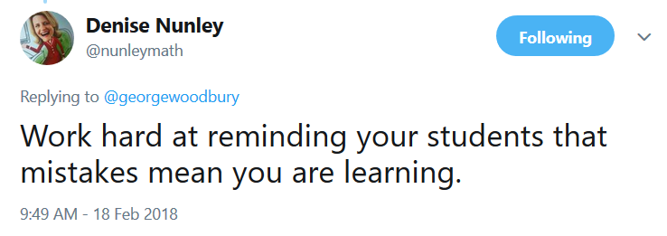
Mistakes

Slide 39
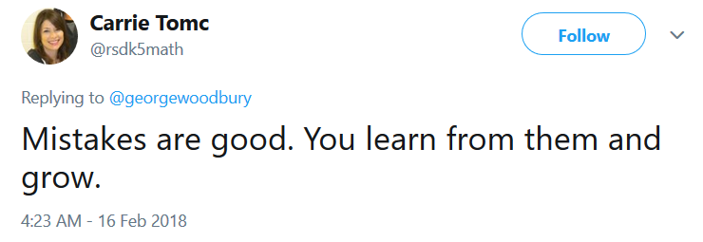
Mistakes

Slide 40
Believe in Your Students

Slide 41
Believe in Your Students
Jo Boaler:
I believe in every one of them, that there is no such thing as a math brain or a math gene, and that I expect all of them to achieve at the highest levels.
I have always known how important it is that students know their teacher believes in them.

Slide 42
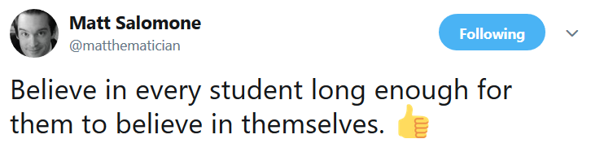
Believe

Slide 43
Speed

Slide 44
Speed
Jo Boaler:
Misconceptions about math: that math is a subject of rules and procedures, that being good at math means being fast at math, that math is all about certainty and right and wrong answers, … .
It is also important to realize that the speed at which students appear to grasp concepts is not indicative of their mathematics potential.

Slide 45
Praise

Slide 46
Praise
Praise growth-mindset, effort-based qualities rather than fixed-mindset, talent-based qualities.
When you tell a student “You are smart” …
Try using “Your hard work is paying off!”

Slide 47
Praise
Carol Dweck:
Students were given a nonverbal IQ test. After they finished half were praised for their ability (“That’s a really good score. You must be smart at this.”), and half were praised for their effort (“That’s a really good score. You must have worked really hard.”).

Slide 48
Praise
Carol Dweck:
The ability-praised students rejected a challenging new task that could expose their flaws and call their talent into question. 90% of the effort-praised students wanted a challenging new task they could learn from.
The performance of the ability-praised students dropped on a second test, while the performance of the effort-praised students improved.
Notes:
So telling children they’re smart, in the end, made them feel dumber and act dumber, but claim they were smarter.

Slide 49
In the Classroom

Slide 50
Changing Student Perceptions of Math
Keith Devlin:
Students will typically say it is a subject of calculations, procedures, or rules. But when we ask mathematicians what math is, they will say it is the study of patterns; that it is an aesthetic, creative, and beautiful subject.

Slide 51
Reasoning
Jo Boaler:
What is the point of explaining their work if they can get the answer right? My answer is always the same: Explaining your work is what, in mathematics, we call reasoning, and reasoning is central to the discipline of mathematics.

Slide 52
Reasoning
Jo Boaler:
They realize they have to use their own minds—thinking, sense making, and reasoning. They stop thinking their task is just to repeat methods, and they realize their task is to think about the appropriateness of different methods.
When students think their role is not to reproduce a method but to come up with an idea, everything changes.

Slide 53
Reasoning
Jo Boaler:
Reasoning also gives students access to understanding.
Reasoning had a particular role to play in the promotion of equity, as it helped to reduce the gap between students who understood and students who were struggling.
It is fairly easy to convince yourself or a friend, but you need high levels of reasoning to convince a skeptic.

Slide 54
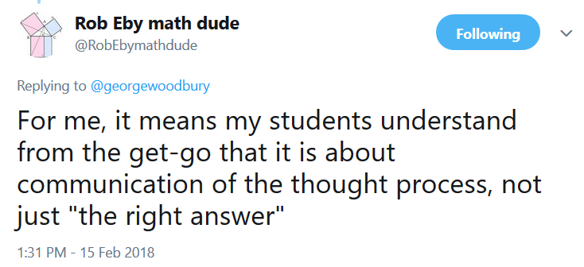
Reasoning

Slide 55
Conclusion

Slide 56
Contact Info
Email: georgew@cos.edu
Twitter: @georgewoodbury
Website: georgewoodbury.com
Mindsets Page: georgewoodbury.com/mindsets

